Slide 1
CARE + CONFLICT Self and collective guiding principles

Slide 2
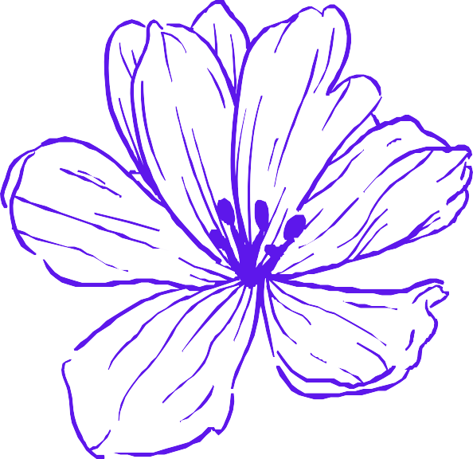
As we vision and build the digital futures we hope to inhabit, it is vital to the Together There ecosystem that staff and residents both actively remain committed to ongoing processes of self and collective reflexivity in order to meaningfully foster a caring, safer, and regenerative work environment.

Slide 3
How can we cultivate a caring, safer, and regenerative collaborative environment?
The following reflective questions are intended to support staff and residents in building a mutually agreed upon set of values that we will continue to explore together.

Slide 4
How can we create an environment that welcomes and embraces each person in their fullness?

Slide 5
What are the tools that may allow us to engage in active listening and compassionate feedback?

Slide 6
How can we collectively encourage and nurture our own and each other's imaginations and dreams?

Slide 7
How do we support our physical, mental, emotional and spiritual health during this residency?

Slide 8
Activity ideas
Initiate Zoom breakout rooms where everyone discusses each prompt and shares their reflections to the group
Ask participants to contribute to a Google Jam Board collective digital collage that responds to the prompts, (i.e., words, images, sights, and sounds, or other senses)
Engage a notetaker or facilitator who can help visually map folks' responses onto a Miro board

Slide 9
Care in times of conflict
Even the most cohesive relationships are not without conflict. In fact, healthy conflict can be a transformative portal for deepened awareness, growth and healing.
Our goal is not to undergo the impossible task of creating a conflict-free environment, but rather to create the conditions for a highly conscious working environment in which there is a communal heart- centered commitment to self-awareness, mutual care and responsive action.
By engaging in intra/interpersonal processes that honour our lived experiences, our differences, and our humanness, we are more effectively able to (re)-centre compassion, empathy and grace within ourselves, and therefore, with each other.

Slide 10
Self reflexivity during interpersonal conflict
Central to the process of mutual care is the relationship we are actively cultivating with self.
To nourish one's relationship with self is to not only steward inner wisdom, it is to build capacity for self-regulatory and restorative practices in times of relational conflict so that we do not perpetuate harm.
In the next slide are guiding prompts and exercises intended to generate self-regulation and self-reflexivity in times of interpersonal conflict.

Slide 11
Guiding prompts for self awareness
What are my values around giving and receiving both care and support?
How can I make my evolving boundaries and capacities known to myself?
What are my values around communication?
What small actions affirm my connections with others?
What are my grounding techniques?
In what areas am I actively healing my relationship to self?
How would I describe my ideal environment for meaningful collaboration with others?

Slide 12
Guiding prompts for self awareness
What does receiving care in times of interpersonal conflict look like for me?
What does providing care in times of interpersonal conflict look like for me?
When conflict emerges, what are the self-regulation practices that help me ground my body and spirit?
What practices remind me to see my experience within a bigger picture of history and relationships?
When I experience a harm and/or a trigger, what would I like for others to be aware of regarding my coping and/or self-regulation processes?

Slide 13
Activity ideas
When conflict arises, what practices allow me to shift from a state of reaction into a state of responsiveness? Feel free to work with reflection questions from previous slides.
Reflect on a recent conflict you were part of, and if you were able to be a fairy godmother to yourself in retrospect. What tools would you have offered yourself? What practices would you invite yourself into? Alternatively, what were you proud of practicing that you would like to affirm?

Slide 14
Collective care
"Showing up for collective dreaming means we must embrace a culture of learning that sees the values in different strategies, resources, and tools that each of us bring to the table. As those in the disability justice movement have taught us, [this] work insists that none of us are left behind."
Annika Hansteen-Izora, "Communal Dreaming"
Collective care is a praxis first introduced to the mainstream by radical disabled women and non-binary people of colour throughout the ongoing disability justice movement. This praxis centres around interdependence as a vital mechanism for ensuring the overall health and wellbeing of individuals and communities.

Slide 15
Guiding prompts for collective care
What is our collective vision, purpose, and values when embarking on this residency together?
How might I communicate my ever-evolving capacity, needs and boundaries with my team?
What are the ideal conditions of a collaborative environment that is conducive to imagination, flow, rest, accessibility and care?
Which characteristic(s) of internalized dominant culture do I most clearly recognize in myself?

Slide 16
Guiding prompts for collective care
What are the ideal ways to reach consent and consensus within group gatherings and decision-making processes?
What are examples of practices and/or processes that cultivate mutuality?
How can we continue to practice reflexivity on the varying impacts of trauma and violence within the team members' individual lived experiences?
How might our team incorporate regular feedback into the ways we work together?

Slide 17
Collective care during interpersonal conflict
How might I frame feedback so that it is constructive and not punitive?
What allows me to feel called in vs. called out?
What are my principles of a courageous conversation?
How can love show up in conversations that also simultaneously hold tension and pain?
How can we move through uncomfortable edges with each other?
What are ideal models for communicating pain points to the team?
What are my after-care needs in times of conflict?
How can the team support me in after-care?

Slide 18
Activity ideas
Possible collective dreaming exercise (i.e., dreaming meditation along the five senses)
Possible daydreaming activity

Slide 19
Thank you for your commitment to embodying the work we have set out to do together

